Slide 1
Notes
HW Questions?
HW Turn in example
File organization
.gitignore
Canvas submission
Midterm date change (Syllabus on Canvas updated)

Slide 2
Operators and Operator Overloading

Slide 3
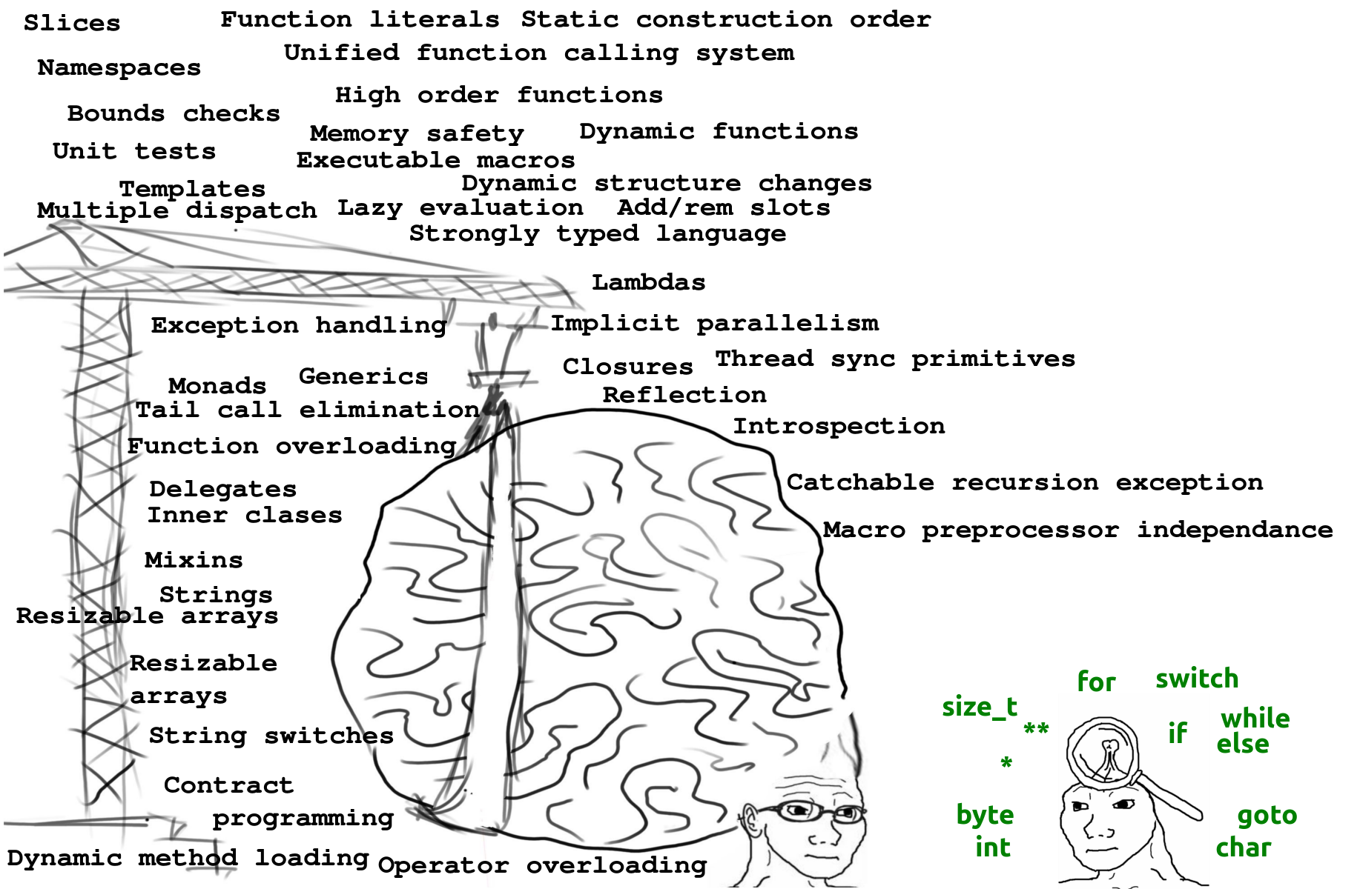

Slide 4
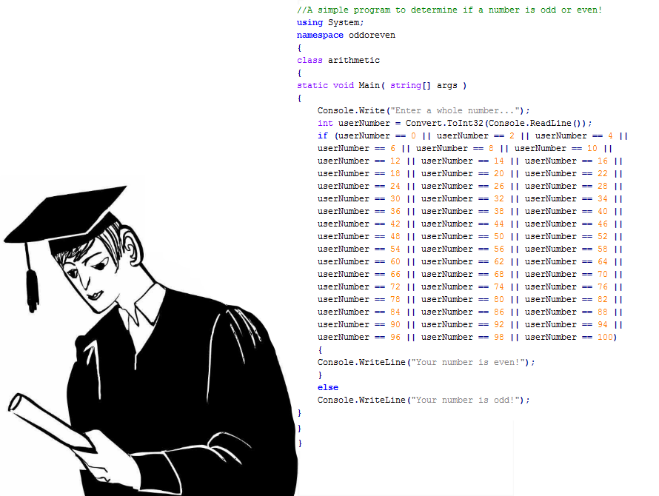

Slide 5
Operators
Programming languages have many operators.
https://docs.microsoft.com/en-us/dotnet/csharp/language-reference/operators/index
However only some are overloadable (you tell the compiler how to handle them).
https://docs.microsoft.com/en-us/dotnet/csharp/programming-guide/statements-expressions-operators/overloadable-operators

Slide 6
Primary Operators
Null conditional operators (prevents null reference exceptions).
X?.Y - Returns null if X is null
X?[n] - Returns null if X is null
Postfix operators – Returns X and then applies the operation
X++
X--
Prefix operators – Applies the operation on X prior to return
--X
++X

Slide 7
Binary Operators
Shift operators
X << Y – Shift bits left y times and fill with 0’s
100101 << 2 = 10010100
X >> Y – Shift bits right y times and fill with 0’s
100101 >> 2 = 1001

Slide 8
Logical & Bitwise Operators
Logical
Bitwise
AND – X & Y
True & False = False
OR – X | Y
True | False = True
XOR – X ^ Y
True ^ False = True
Note: The only difference between & and && is that & will check both operands even if the first returns false. && will not check the 2nd operand if the first is false.
Stopping when you know it has failed (or passed) is called short-circuit evaluation.
AND – X & Y
11010 & 10010 = 10010
OR – X | Y
11010 & 10010 = 11010
XOR – X ^ Y
11010 & 10010 = 1000
Bitwise complement ~
~(11110000) = (00001111)

Slide 9
Relational Operators
“is” – Type compatibility. Returns true if left operand can be cast to right operand.
if (object is Animal)
Type conversion
“as” – Returns the left operand cast as the right operand. Will return null if not compatible.
(Type)object – Same as “as”. Will throw exception if not compatible.

Slide 10
So Many More Operators
Math
*, /, +, -, %
*=, /=, +=, -=, %=
Binary
&=, |=, ^=, <<=, >>=
Comparison
<, >, ==, <=, >=, !=
Conditional
&&, ||

Slide 11
Overloading Operators
The compiler is very, very intelligent.
However, it doesn’t know how to add Cows, Cars, or any other custom object type you create.
C#, as well as many other programming languages (not Java…) offer the ability to overload operators.
This means that you can tell the compiler what it means to add two cows together.
Cow + Cow = ?

Slide 12
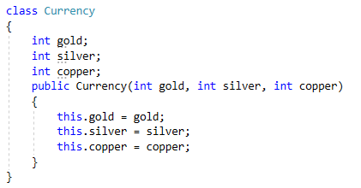
A Good Example
RPG style game where players have a currency that consists of gold, silver, and copper.
100 copper can be traded for 1 silver, visa versa
100 silver can be traded for 1 gold, visa versa
Our currency class looks something like this =
Lets say player A wins an event that rewards 5 gold, 10 silver, and 95 copper.
A.currency += new Currency(5, 10, 95)
Assuming we have overloaded the + operator

Slide 13
Overloadable Operators
Unary Operators
+, -, !, ~, ++, --, true, false
Binary Operators
+, -, *, /, %, &, |, ^, <<, >>
Comparison Operators
==, !=, <, >, <=, >=
Conditional Operators
&&, ||
Note: Assignment operators like +=, or *= are implicitly overloaded when you overload the corresponding binary operator.

Slide 14

Operation Overloading Signature Breakdown
“public” – What is the point of having an operator if you can’t use it?!?!?
“static” – Remember, static makes whatever it is a member of the class instead of the object
We only need one overloaded operator that every Currency object can understand.
“operator” – Simply declaring that we are overloading an operator
“+” – The operator we are wanting to overload
Parameters – For binary operations, two of the class you are overloading. For unary operations, just one.

Slide 15
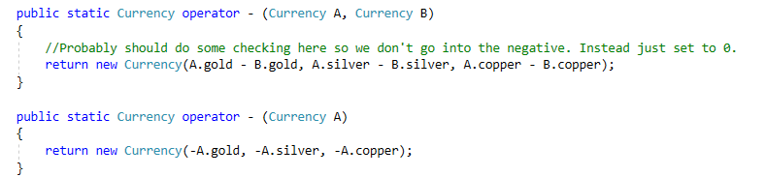
Unary VS Binary
Top operator is subtraction
Bottom operator is negation
Compiler knows the difference based on the number of parameters.

Slide 16
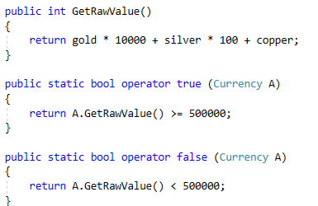
Weird Operators to Overload
Checking accounts often require a certain balance in order to stay active.
Overloading the true and false operators allow us to write something along the lines of, “if you have 50 gold’s worth of currency or more, you are valid.”

Slide 17
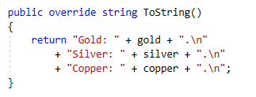
The go-to overload for objects
Printing objects is useful in many situations
Inform the user
Debugging
Console.WriteLine(new Currency(5, 3, 4));
Gold: 5.
Silver: 3.
Copper: 4.

Slide 18
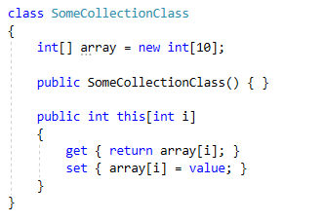
Adding Indexers
If you want to access some object via indexers.
Think arrays, lists, etc.
Example:
Working on a project with an AIManager.
There are n AI actors in the project.
Instead of writing a method to get access to a single AI actor, write an indexer using a dictionary to the character name.
AIManager[CharacterName.Bob]

Slide 19
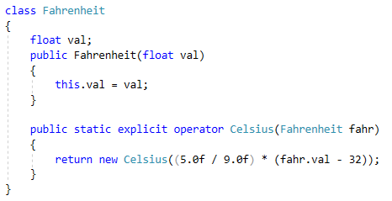
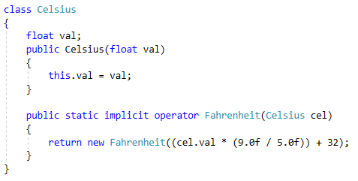

Explicit & Implicit Casting

Slide 20
The Goal
As always, our goal is to make our code more:
Reusable
Easy to understand
Easy to use
More dynamic
Overloading operators helps in all of these ways.

